Slide 1
Final Project---
Top-music
\
By: Weihao Jiang; Shuaipeng Liu

Slide 2
CONTENTS
First
Second
Intentions and Data sources
Dataset
Third
Analysis
Fourth
Sample show

Slide 3
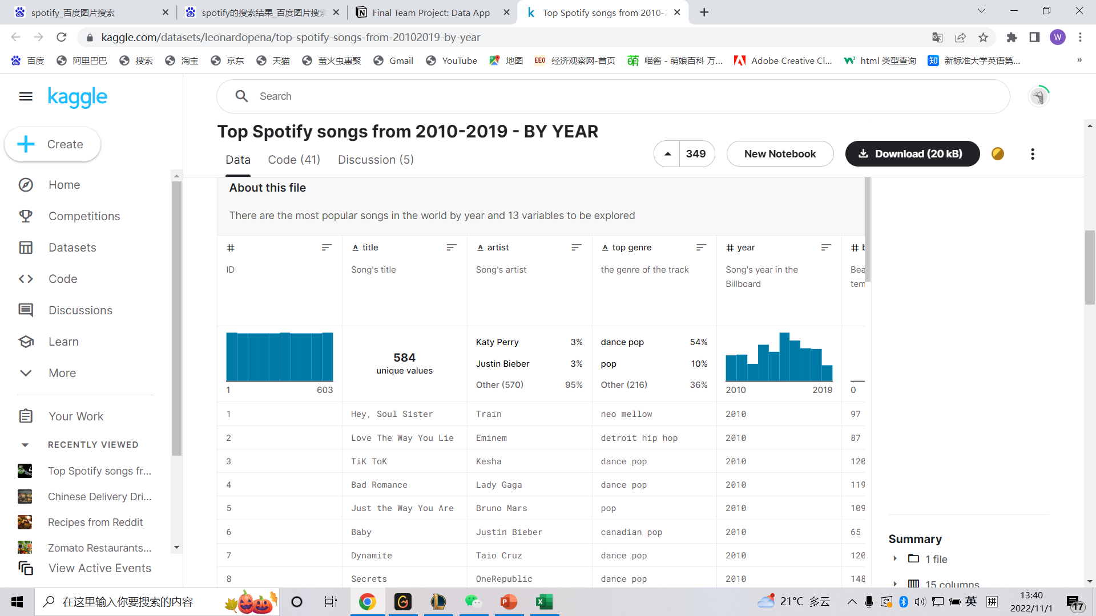
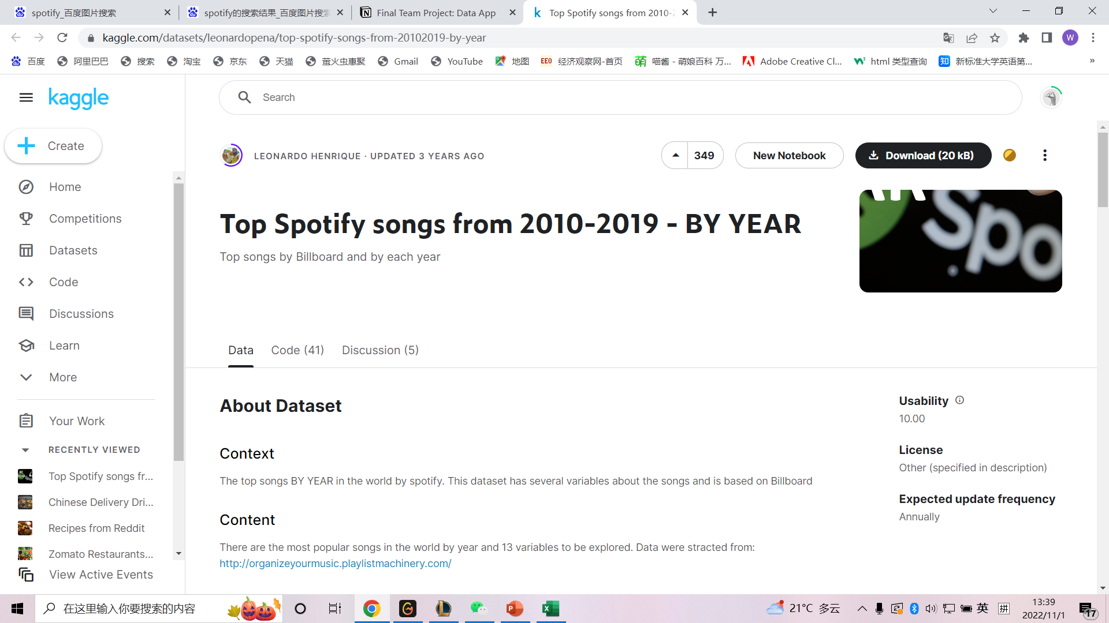
Ⅰ
Date Sources
https://www.kaggle.com/datasets/leonardopena/top-spotify-songs-from-20102019-by-year

Slide 4

Ⅰ
Intention
Music has a lot of dimensions to consider so there will be various kinds of problems in it
We choose some relative columns to analyze the relationship between those column
.

Slide 5
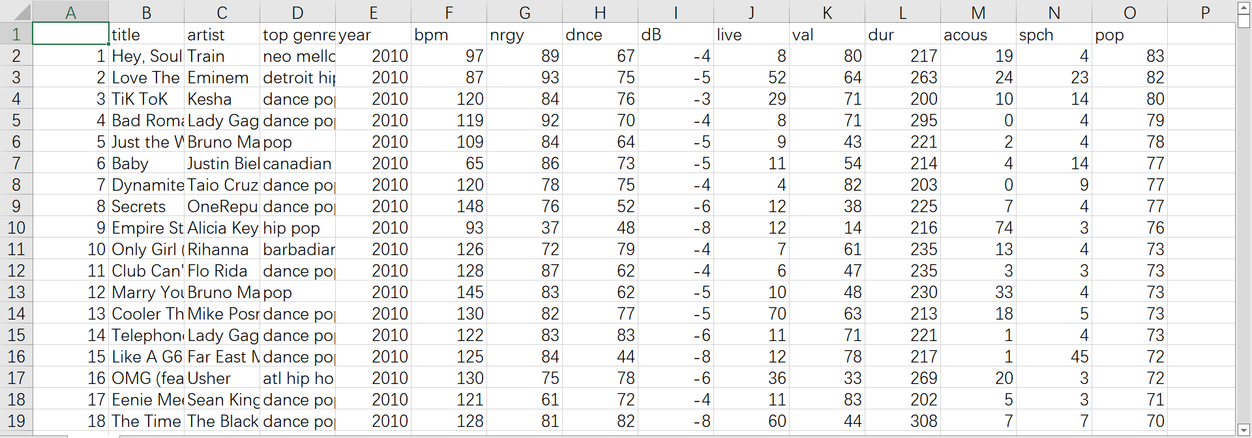
Ⅱ
Dataset
The column we used
.
.

Slide 6
Ⅱ
Dataset
Columns used as labels
Artist
Year
Top genre
Which artist sing or produce this song.
The year in which the song is on the board
What type of music it is.

Slide 7
Ⅱ
Dataset
For data analyze
BPM
A number to show how fast the beat is.
A higher bpm means faster.
Live
Live means liveness which shows how strong the song make you feel in live. A higher value means stronger feeling
Pop
Pop means popularity.
A higher value means more popular.

Slide 8
Ⅲ
Analysis
What plot we use?
What aspect we discuss in our program?
We use bar, histogram as well as box
we discuss the relationship between popularity and bpm based on different music type and year
How we interact with users？
We use multiple choice to choose music type, use form to input year, use slider and radio to choose bpm
We also discuss relationship between liveness and bpm based on different type and year

Slide 9
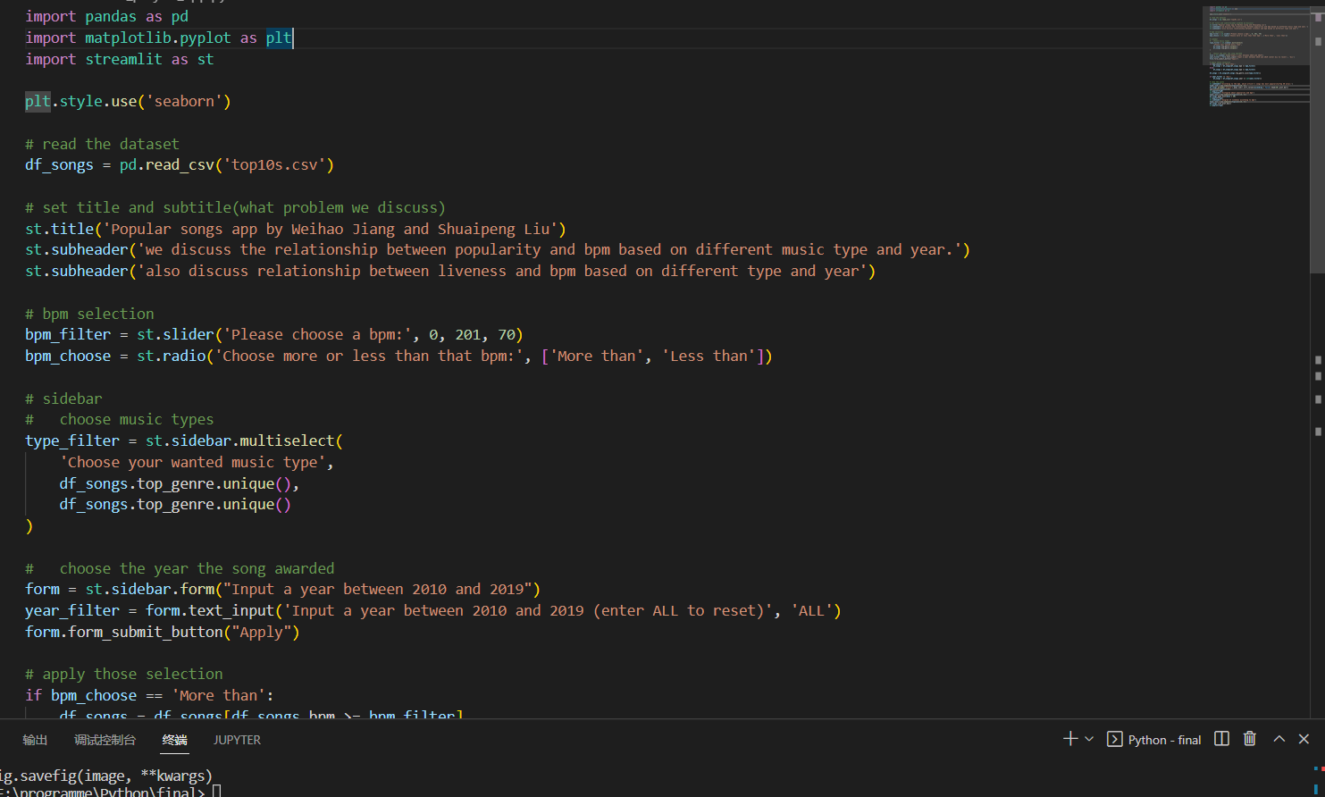
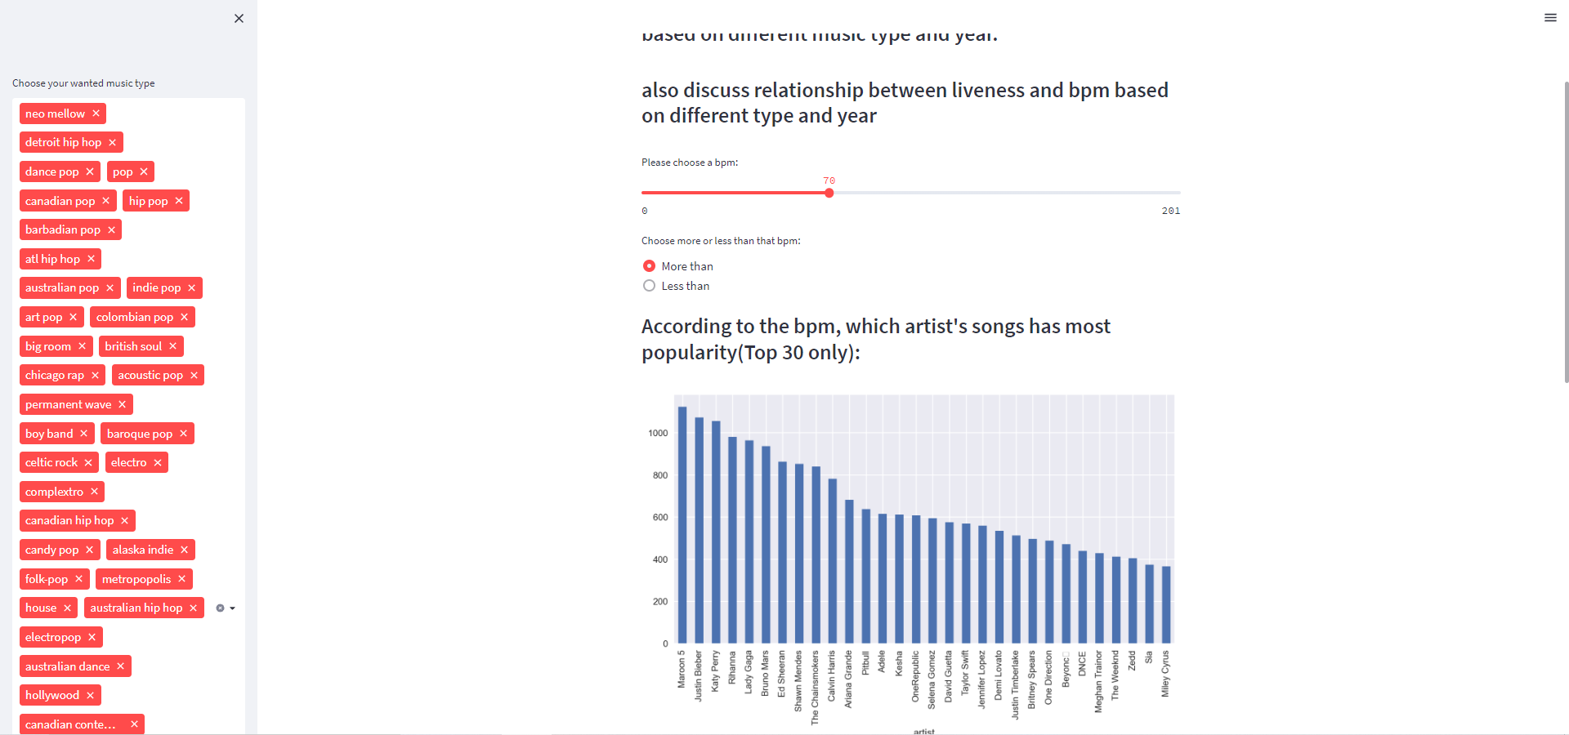
Ⅲ
Analysis
.
.

Slide 10
Ⅳ
Sample Show
Let’s show our application to you all.
Readme: https://jokerkingdo.github.io/Final_app_JokerAndWolf/
Git-Hub: Final_app_JokerAndWolf
App: final_app_jokerandwolf ∙ main ∙ final_project_app.py

Slide 11
THANK YOU
For your listening!

